Slide 1




KABIR AHMAD
Presentation
Xaxor AI Bootcamp
29/05/2024

Slide 2

ADVANCED PRE PROCESSING TECHNIQUES
1
2
3
4
SEMANTIC ROLE LABELING
(SRL)
CONTEXTUAL EMBEDDING
NAMED ENTITY RECOGNITION (NER)
NATURAL
LANGUAGE
INFERENCE
(NLI)

Slide 3
SEMANTIC ROLE LABELING
(SRL)
The process of identifying the predicate-argument structure of a sentence, essentially determining who did what to whom, when, where, etc.
PREDICATE IDENTIFICATION
ARGUMENT IDENTIFICATION
ARGUMENT CLASSIFICATION
SRL helps in understanding the deeper meaning of a sentence by identifying these relationships.

Slide 4
SEMANTIC ROLE LABELING
(SRL)
LIBRARY
“ ALLENNLP ”
SENTENCE
“The chef cooked a delicious meal for the guests in the evening.”
RESULT
Predicate: cooked
Arguments: [ARG0: The chef] [V: cooked]
[ARG1: a delicious meal]
[ARG2: for the guests]
[ARGM-TMP: in the evening]

Slide 5
CONTEXTUAL EMBEDDING
Contextual Embedding refers to word embeddings that capture the meaning of a word in the context of a sentence, as opposed to static embeddings like Word2Vec or GloVe which assign a single vector to a word regardless of its context.
Embeddings from Language Models
Generates embeddings for words considering their surrounding words. It uses bidirectional LSTM networks to create context-aware embeddings.
Bidirectional Encoder Representations from Transformers
Uses a transformer architecture to generate embeddings that consider the context from both directions
ELMO
BERT

Slide 6
CONTEXTUAL EMBEDDING
“ TRANSFORMERS, AUTOTOKENIZER ”
LIBRARY
SENTENCE
“The chef cooked a delicious meal for the guests in the evening.”
tensor([[[ 0.1370, -0.1916, -0.4349, ..., -0.1848, 0.1336, -0.2597],
[-0.4665, -0.1544, -0.5044, ..., -0.2098, 0.4982, 0.0161],
[ 0.2236, 0.0223, 0.4061, ..., 0.3373, 0.2414, 0.1275],
...,
[ 0.0503, -0.0612, 0.1524, ..., 0.0045, 0.3495, -0.0895],
[-0.3473, 0.0338, -0.1118, ..., 0.0542, -0.2061, -0.0311],
[-0.0578, 0.0362, -0.2267, ..., 0.1051, 0.0887, -0.0371]]])
CONTEXTUAL EMBEDDINGS

Slide 7

NAMED ENTITY RECOGNITION (NER)
The task of identifying and classifying entities in text into predefined categories such as names of persons, organizations, locations, dates, etc.
“ Google was founded by Larry Page and Sergey Brin in California ”
PERSON
PERSON
LOCATION
ORGANIZATION

Slide 8
NATURAL LANGUAGE INFERENCE (NLI)
Commonly known as Recognizing Textual Entailment (RTE), the task of determining the logical relationship between two sentences.
ENTAILMENT
CONTRADICTION
NEUTRAL
The truth of one sentence implies the truth of the other (e.g., "A dog is running" entails "An animal is running").
One sentence contradicts the other (e.g., "A dog is running" contradicts "No animals are running").
The truth of one sentence does not affect the truth of the other (e.g., "A dog is running" and "It is raining" are unrelated).

Slide 9

NATURAL LANGUAGE INFERENCE (NLI)
“ TRANSFORMERS, PIPLINE ”
LIBRARY
PREMISE
"The chef cooked a delicious meal."
HYPOTHESIS
"The guests ate a delicious meal."
RESULTS

Slide 10
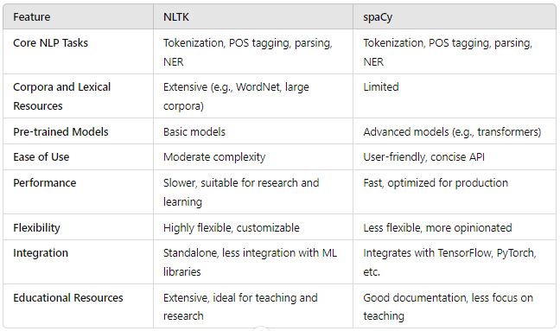
COMPARISON

